Slide 1

PERFORMANCE ANALYSIS OF EMPLOYEES IN DIFFERENT DEPARTMENT
DATA DASHBOARD AND VISUALIZATION USING ADVANCED EXCEL

Slide 2

CONTENTS
IDEA BEHIND THE ANALYSIS | OBJECTIVES | OUTLOOK OF DATA | DATA PROCESSING STEP | CONDITONAL FORMATTING,
BUSINESS INSIGHTS | FINDINGS FROM ANALYSIS | GLIMPSE OF FINAL DASHBOARD | CHARTS PIVOT | IF FUNCTION VLOOKUP DATA VALIDATION

Slide 3

IDEA OF THIS ANALYSIS
IDEA BEHIND THE ANALYSIS
This Analytical study is based on the Performance of employees in different departments.
Here I try to Analysis department wise number of employees and their performance on the basis of the ratings and the Experience they have gained in the past working years on their particular field and their salary hike etc.

Slide 4

MAIN OBJECTIVES
Which department has Highest number of Employees?
From which department Employees are getting higher salary?
DEPARTMENT
Up to how much years of experienced employee get higher salary?
Does Experienced employees have any impact on good rating?
EXPERIENCE
Does higher age impact on salary.
How many employees are in each department has good ratings?
AGE/RATING
LOCATION
Does far distance to office has any impact on number of employees?

Slide 5
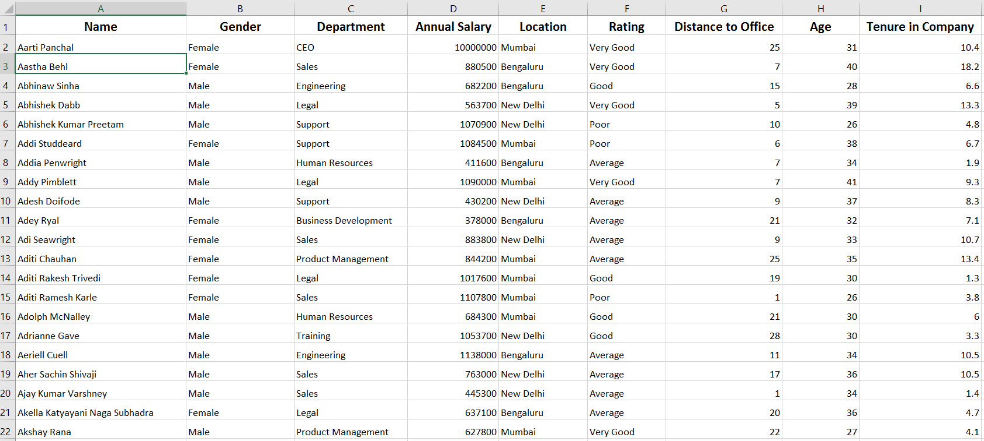
DATA OUTLOOK

Slide 6

DATA PROCESSING STEP
RAW DATA
Raw Dataset was in CSV format.
Different Excel tools and Functions use to analyze Objective.
Conditional Formatting, Data Validation, Look ups, IF Function, Slicer, Pivot, Charts.
Dashboard
DATA ANALYSIS
PRE-PROCESSING
Data Converted to Excel format.
Remove Unnecessary Data.
BUSINESS INSIGHTS

Slide 7
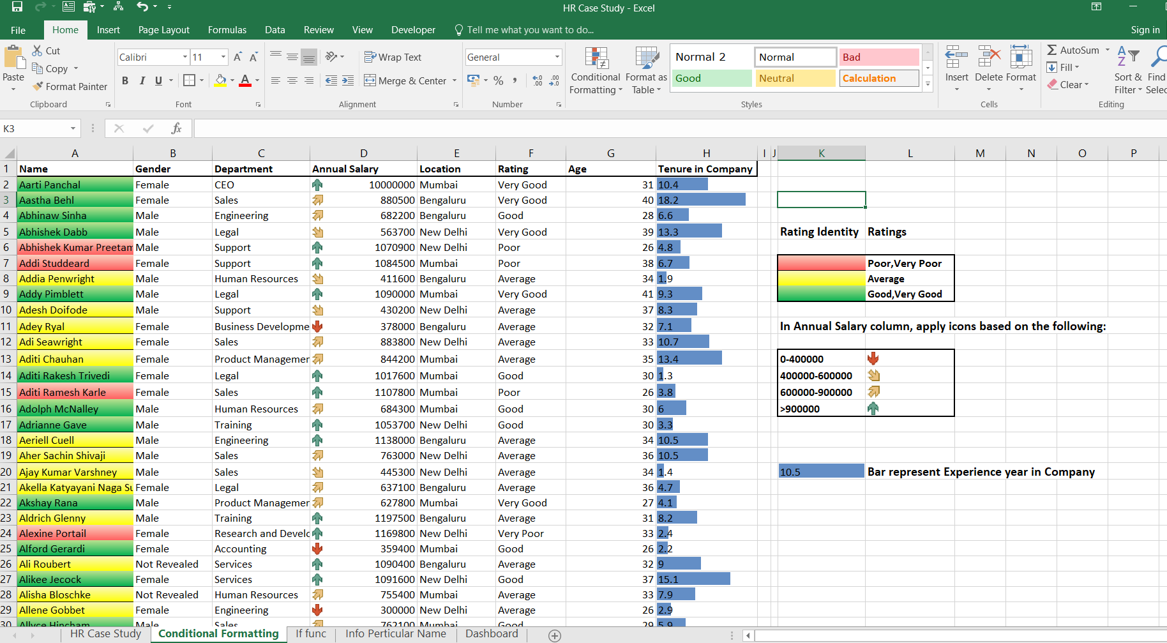

Slide 8
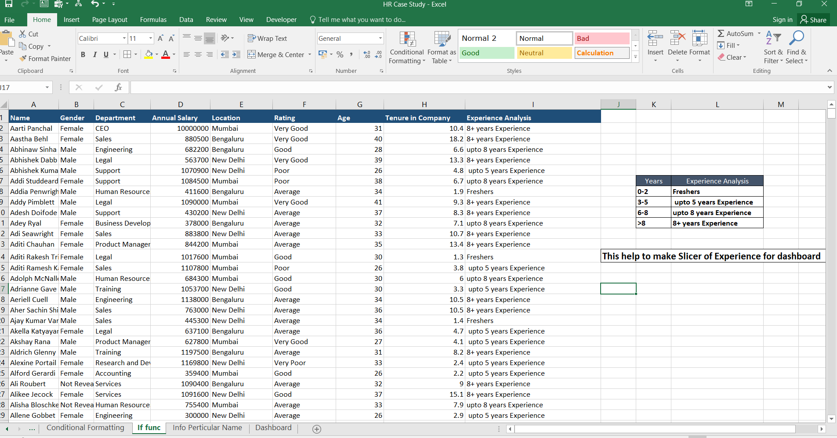

Slide 9
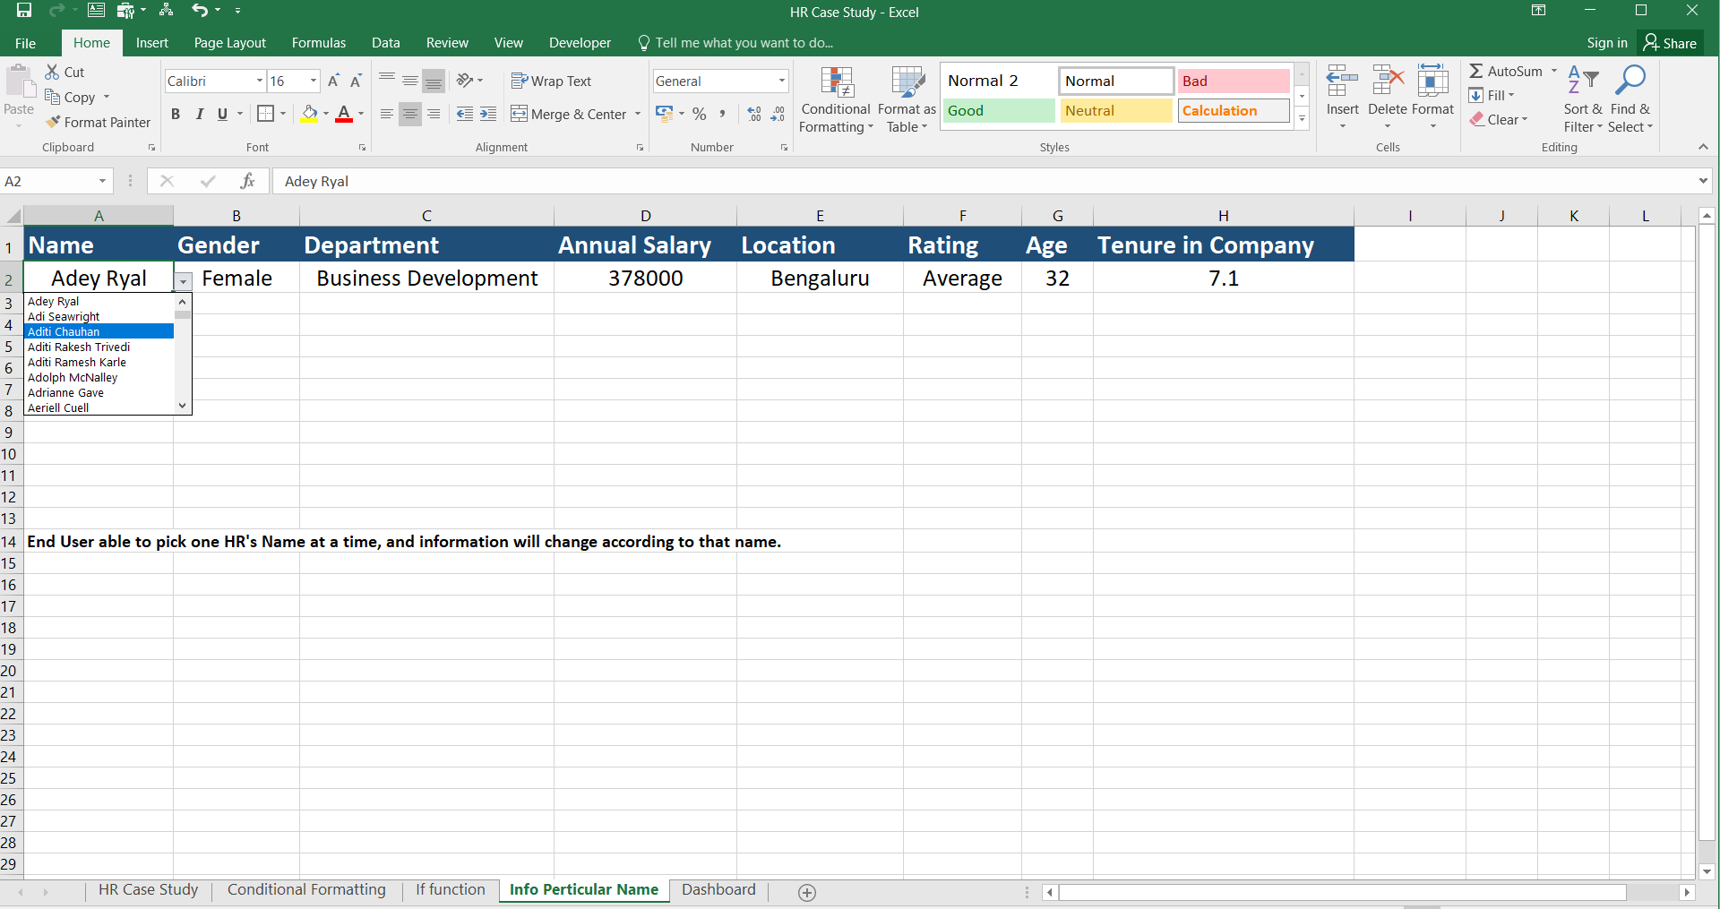

Slide 10
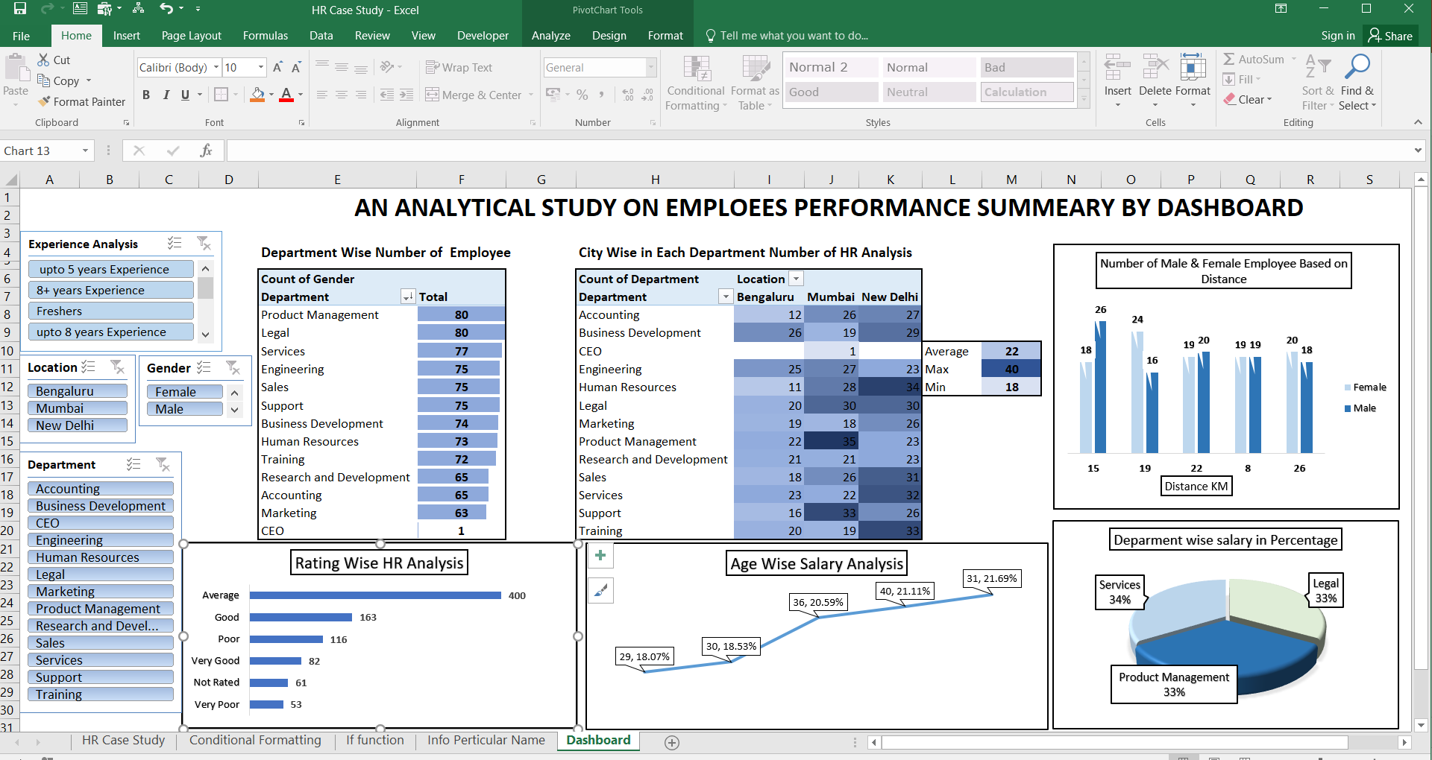

Slide 11

CONDITIONAL FORMATTING
CONDITIONAL FORMATTING
Used for,
Identify Ratings of employees by color Salary range of employees by Icon Experience Year of employees by bar
IF FUNCTION
Used for,
From Tenure in Company Column IF function
helps to make Slicer of Experience for dashboard
VLOOKUP FUNCTION & DATA VALIDATION
Used for,
End User will able to pick one employee's Name at a time, and information will change according to that name

Slide 12

KEY FINDINGS
The highest number of employees are in department of Product Management followed by Legal and Sales .
The Bangalore city has highest number of Business Development and Engineers.
In Mumbai city the Training and Marketing has low Employees.
New Delhi has the maximum number of Employees in each department among the 3 cities.
Over all maximum customers are coming from 15-25km distance.
Maximum number of employees are getting ‘Average’ rating where as ‘Very Good’ rating is low.
Above the age of 30 the salary is high whereas 31 to 36 aged are getting highest salary followed by 40, 30,29 age person.
Maximum Salary of female on department of Legal, Business Development.
for Male on Product Management, service and Training.

Slide 13

INSIGHTS
Based on the Performance of the Employees some proposition can be suggested.
They are:
Over all employees are getting average ratings though they have up to 6 to 9 years of experience, so employees should ask customers for reason behind this rating, according to that they can improve their working performance.
In department of Research & Development, Accounting and Marketing employees are less, these are important departments of business so HR should hire more employees in that area.

Slide 14



Swarnashee Dutta
swarnashreedutta7@gmail.com
THANK YOU!

